Slide 1
JavaScript Objects and DOM Manipulation
Lesson 11.2

Slide 2

The Big Picture
Python Unit
Python
Pandas
Matplotlib
APIs
Unit Assessment
Final Project
Project Design
Train Model & Build Database
Dashboards Presentation
Python Unit
Python
Pandas
Matplotlib
APIs
Unit Assessment
Visualization Unit
Web Scraping
Plotly
Leaflet
Tableau
Unit Assessment
Visualization Unit
Web Scraping
Plotly
Leaflet
Tableau
Unit Assessment
01
03
03
05
02
06
02
04
04
Excel Unit
Excel
VBA
Unit Assessment
Databases Unit
SQL
ETL
SQLite
Unit Assessment
Databases Unit
SQL
ETL
SQLite
Unit Assessment
Advanced Topics Unit
R—Stats
Big Data—AWS
Machine Learning
Unit Assessment
Notes:
Data

Slide 3
This Week: JavaScript Objects and DOM Manipulation
Module 11

Slide 4
This Week: JavaScript Objects and DOM Manipulation
By the end of this week, you’ll know how to:
Create, update, and iterate over JavaScript Objects.
Use forEach() and callback functions
Use D3.js for basic DOM manipulation
Populate and filter tables using static data structures
Use D3.js to attach events to DOM elements
Dynamically manipulate the DOM through events

Slide 5
Using the skills learned throughout the week, create new search parameters and new JavaScript functions for UFO data to create an updated and dynamic webpage.
Notes:
For this week's Challenge, let the students know that they'll create four additional search parameters, one for the city, state, country, and shape of the UFO in addition to the date filter they created in the module. Using JavaScript they will create two new functions, one to save the element, value and id of the filter that was changed, and then filter the UFO dataset with the search criteria, and update the webpage.

Slide 6
Today’s Agenda
Module 11

Slide 7

Today’s Agenda
By completing today’s activities, you’ll learn the following skills:
01
Use forEach() and callback functions
02
Create, update, and iterate over JavaScript objects
03
Attach and manipulate the DOM with D3.js
Make sure you’ve downloaded any relevant class files!

Slide 8
How comfortable do you feel with this topic?

Slide 9
forEach and Callbacks
20 minutes
Notes:
2.1 Everyone Do: forEach and Callbacks (0:20)

Slide 10


forEach
for loop
Notes:
Compare the forEach method to the traditional for loop. While both loop over an array, a for loop will repeat until a specified condition is met, while forEach will call a function once for each element.
Image source: AdobeStock_197664486

Slide 11

JavaScript often provides more than one way to perform an analysis task: for instance, forEach and for loops.

Slide 12
JavaScript Objects
Notes:
3.1 Instructor Do: JavaScript Objects (0:10)

Slide 13
What is JSON?

Slide 14
JSON is a syntax for storing and exchanging data.

Slide 15
What is JSON?
JSON is a syntax for storing and exchanging data.
J
Java
S
Script
0
Object
N
Notation

Slide 16
JSON
JSON is similar to a Python dictionary in many ways:
Information is organized in key and value pairings.
They are unordered.
key is used to access the value.
Notes:
Explain to students that JavaScript objects are similar to Python dictionaries. Assure students that their ample experience in using Python dictionaries, as well as parsing and dealing with JSON data (JavaScript Object Notation), will serve them well today.
Take a moment to summarize some things we know about Python dictionaries:
They organize information in key and value pairings.
Unlike lists, key-value pairs are unordered.
The key is used to access the value.

Slide 17
JavaScript Objects
Notes:
3.1 Instructor Do: JavaScript Objects (0:10)

Slide 18
Activity: Word Frequency Counter
In this activity, you will create a function in JavaScript that uses the forEach() method to count the number of occurrences of each word in a string.
15 minutes
Notes:
3.2 Students Do: Word Frequency Counter (0:15)

Slide 19
Instructions: Word Frequency Counter
Instructions | Hints
Create a function in JavaScript that counts the number of occurrences of each word in a string. | How would you split a string into an array of words? Start the word frequency counter an empty object. How would you determine whether a word already exists in the object?
The function should take in a string as its parameter.
Use an object to hold word frequency in key-value pairs. For example, the following will be the frequency list for the string "I yam what I yam and always will be what I yam"
{
I: 3,
always: 1,
and: 1,
be: 1,
what: 2,
will: 1,
yam: 3,
}

Slide 20
Notes:
3.3 Review Word Frequency Counter (0:05)

Slide 21
HTML Tables

Slide 22
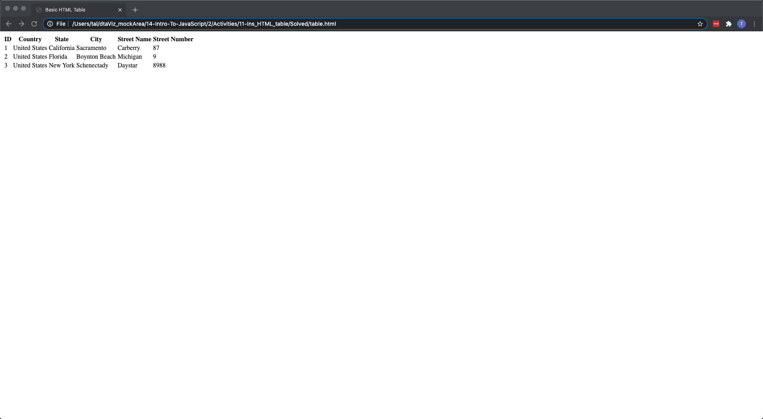
HTML Tables
A table is created using a pair of table tags.
Each row of the table is created using tr tags.
For header rows, a special th tag is used to denote the header cells.
td tags are used to define table cells. td stands for Table Data and represents each cell of data in the table.
The nesting here is important: You always have table cells (td) within rows (tr).
Notes:
Explain that data tables have their own HTML syntax.
Leave this slide while you demo the activity solution in the browser and then open table.html in an editor to explain the following points about HTML tables:
A table is created using a pair of table tags.
Each row of the table is created using tr tags.
For header rows, a special th tag is used to denote the header cells.
td tags are used to define table cells. td stands for Table Data and represents each cell of data in the table.
The nesting here is important. You always have table cells (td) within rows (tr).

Slide 23
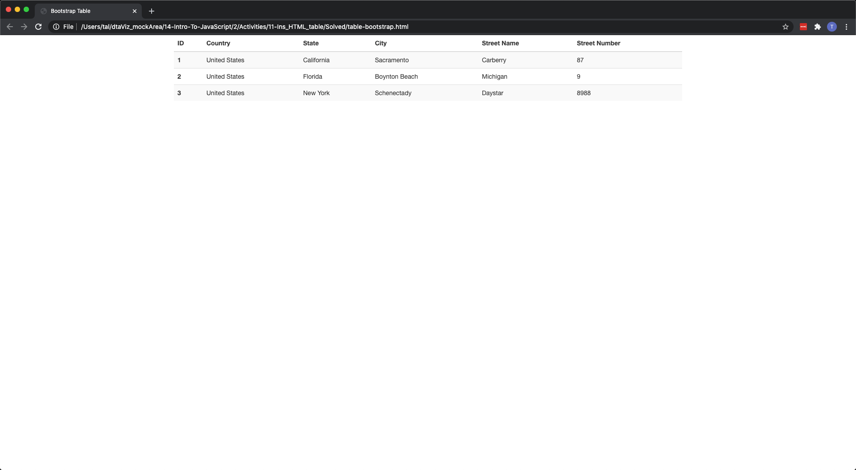
HTML Tables
Bootstrap allows you to create visually appealing data tables.
Bootstrap adds additional table classes to the HTML tags to style the table.
Bootstrap tables also use thead and tbody tags to separate the table header code from the table body code.
Within thead, the header is still defined using a tr row with th tags for header cells.
tbody uses one tr tag per row, with td tags per data cells.
Notes:
Explain that we can use Bootstrap to create visually appealing data tables.
Slack out the link to the Bootstrap Tables Documentation for students to use as a reference.
Next, demo the Bootstrap solution in the browser and open bootstrap-table.html in an editor to explain the following points about HTML tables:
Bootstrap adds additional table classes to the HTML tags to style the table.
Bootstrap tables also use thead and tbody tags to separate the table header code from the table body.
Explain that within thead, the header is still defined using a tr row with th tags for header cells.
Explain that tbody uses one tr tag per row with td tags per data cells.
Explain that manually building HTML tables can become a tedious task, but JavaScript can be used to automate this. The next class will cover dynamically building tables with JavaScript.

Slide 24
HTML Tables
Notes:
4.1 Instructor Do: HTML Tables (0:05)

Slide 25
D3 Table
20 minutes
Notes:
4.2 Everyone Do: D3 Table (0:20)

Slide 27
Event Listeners

Slide 28
What is an Event?

Slide 29
An event is an action by the user or the browser that JavaScript (listens) can detect and react to by executing code (interact HTML).

Slide 30
Event Types
There are several event types that are supported by the browser, including:
click
change
Keydown
scroll
pointerenter
pointerleave
Notes:
Explain that the activities so far have selected or appended elements in the HTML. This code is executed once upon loading the browser. What makes JavaScript really interesting is that it can listen for user events on the page and execute code when these events are detected. This provides an incredibly powerful mechanism for building dynamic and interactive applications.
Inform the class that several event types are supported by the browser including:
click
change
keydown
keyup
scroll
pointerenter
pointerleave
and many more!
Slack out a reference to web events.

Slide 31
D3 Event Listeners
Events have two main components:
01
A target: a reference to the object that dispatched the event.
02
A handler: a function that is executed in response to the event occurring.
function handleClick() {
console.log("A button was clicked!");
console.log(d3.event.target);
}
Notes:
Before demonstrating any syntax, explain that events have:
A target: a reference to the object that dispatched the event.
A handler: a function which should be executed in response to the event occurring.
Also:
Event handlers are just normal functions that you call when an event occurs. // This function is triggered when the button is clicked
function handleClick() {
console.log("A button was clicked!");
// We can use d3 to see the object that dispatched the event
console.log(d3.event.target);

Slide 32
D3 Event Listeners
In D3, events are attached using the .on() function.
Alternatively, the click handler can be defined inline.
button.on("click", handleClick);
button.on("click", function() {
console.log("Hi, a button was clicked!");
console.log(d3.event.target);
});

Slide 33
D3 Event Listeners
They are just like functions that can execute code or call other functions.
Input elements can trigger change events.
button.on("click", function() {
d3.select(".giphy-me").html("<img src='https://gph.to/2Krfn0w'alt='giphy'>");
});
inputField.on("change", function() {
var newText = d3.event.target.value;
console.log(newText);
});
Notes:
Event handlers are just normal functions that can execute code or call other functions. button.on("click", function() {
d3.select(".giphy-me").html("<img src='https://gph.to/2Krfn0w' alt='giphy'>");
});

Slide 34
D3 Event Listeners
Notes:
5.1 Instructor Do: D3 Event Listeners (0:10)

Slide 35
Activity: On Change
In this activity, you will use D3 to reverse the input text and display it on the page.
15 minutes
Notes:
5.2 Students Do: On Change (0:15)

Slide 36
Instructions: On Change
Instructions | Bonus | Hints
Use d3 to select the input (#text) and output (.output) elements from the page. | Instead of reversing the string, try to calculate the number of characters in the string. | You may need to iterate through the object using Object.entries and forEach.
Use d3 to attach an event listener to the input field. This event should call the handleChange function any time that the input text changes.
Finally, complete the handleChange function to select the text from the input field and reverse the string. This function will use d3 to set the output element to the value of the reversed string. | Edit the index.html file to change the h1 tag to an unordered list ul. Append each word: count as a li element.

Slide 37
Notes:
5.3 Review: On Change (0:05)

